Slide 1
DATA-LA 485
Presenting Results

Slide 2
Goals for Tuesday:
Written Report – 2-3 pages (~500-750 words), visuals/code not included.
Due next Tuesday
Presentation – one per team, not longer than 15 minutes.
* Practice makes perfect (or at least, cohesive)

Slide 3
Written Report
Introduction: The introduction should define the research question, why it is important, and include a brief review of the key literature.
Methods: Describe details about the dataset, the variables that you use for your analysis, and the analysis/analyses you conduct. Generally, you should provide enough detail so that another person could re-run your analysis.
Results: Provide descriptive statistics of the data, report results from analysis and provide graphical displays of your analyses. You should also test your assumptions and mention them here. Be sure to include nice charts!
Discussion: Interpret your results and discuss any limitations. You might want to discuss whether there were any problems with the dataset or the variables collected. Are there alternative interpretations to your study? From this study, what future work needs to be conducted?

Slide 4
Presentation
Introduction
List the research question
Describe the hypothesis
Provide a brief review of key literature
Methods
Provide details on how the data was collected, the sample size, the variables you included in your analysis
Describe the statistical analyses you conduct and your independent / dependent variables.
Results
Include descriptive statistics, graphs and/or summaries of your independent, dependent (and any other) variables
Include a figure of the relationship between your independent and dependent variable
Report the results of your analyses
Mention whether or not the assumptions of your test were met
Discussion / Conclusion
Interpret your results in the context of your original question
Describe the limitations of your analysis
What future work should be done in this area

Slide 5
New Question
Does time spent with puppies (no time, 15 minutes, 30 minutes) influence happiness.
Data set = puppies.csv

Slide 6
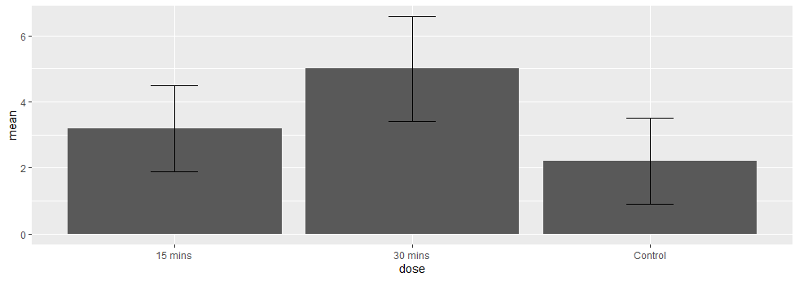
Please create a chart to visually examine differences across the three groups
library(tidyverse)
puppies <- read_csv("puppies.csv”)
gmeans <- puppies %>% group_by(dose) %>% summarize(mean=mean(happiness), sd=sd(happiness))
gmeans %>% ggplot(aes(dose, mean)) + geom_bar(stat="identity") + geom_errorbar(aes(ymin=mean-sd, ymax=mean+sd), width=0.2)

Slide 7
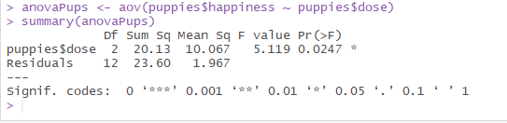
Identify the statistical test you should conduct to determine if teaching method is associated with student exam scores.
anovaPups <- aov(puppies$happiness ~ puppies$dose)
summary(anovaPups)

Slide 8
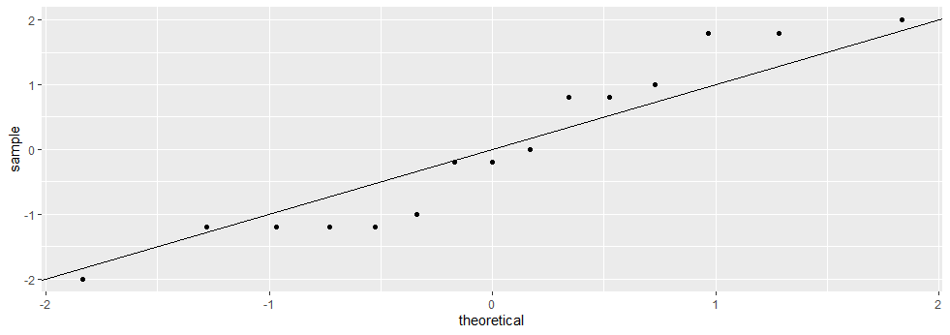
Test the assumptions of the model and comment on whether our data violate the assumptions of your model.
The residuals are normally distributed
res <- residuals(anovaPups)
#3 ways to test
qqnorm(res)
ggplot() + geom_qq(aes(sample=res)) + geom_abline()
shapiro.test(res)
#Key is to interpret:
#The p-value of the shapiro-wilk tests provide evidence that the data is relatively normal.

Slide 9
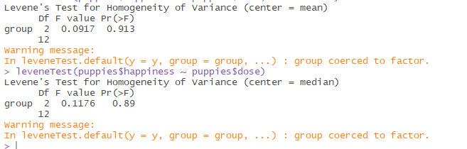
Test the assumptions of the model and comment on whether our data violate the assumptions of your model.
2. Homogeneity of variance
#2 ways to test
library(car)
leveneTest(puppies$happiness ~ puppies$dose, center=mean)
leveneTest(puppies$happiness ~ puppies$dose)
#Key is to interpret:
#The p-value of the Levene test is > 0.05 suggesting that the variances are similar
#The p-value of the Brown-Forsythe test is > 0.05 suggesting that the variances are similar

Slide 10
Test the assumptions of the model and comment on whether our data violate the assumptions of your model.
3. Independence
#We have to assume that the data was collected from unique individuals and is independent

Slide 11
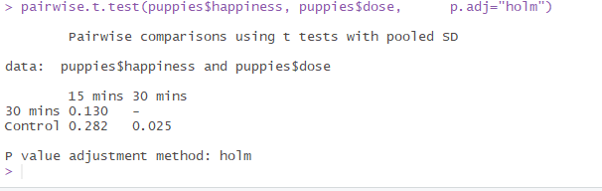
Please run the appropriate analysis to determine if different teaching methods affect student’s learning.
#Run the appropriate analysis to determine if time with puppies influences happiness
anovaPups <- aov(puppies$happiness ~ puppies$dose)
summary(anovaPups)
#The ANOVA results suggests there is a significant difference (p < 0.05)
#To interpret these results, we need to run a post-hoc test
pairwise.t.test(puppies$happiness, puppies$dose, p.adj="holm")

Slide 12
Interpret the results of your analysis. What would you conclude?
This is the most important part!
The results of our ANOVA test show a significant difference in happiness across the three groups that were exposed to puppies (none, 15 minutes, 30 minutes). The pairwise post-hoc test (using a Holm correction to keep our family-wise error rate <= 0.05) shows that happiness is significantly different between our control and 30 minute groups, but the 15 minute group is not significantly different than either.
If you are going to submit your results for publication, be sure to check the requirements of that journal:
There was a significant effect of puppy therapy on levels of happiness, F(2, 11.57) = 5.12, p = 0.026. Post hoc comparisons using the Holm test indicated that the mean score for the control condition (M = 2.20, SD = 1.30) was significantly different from the 30 minute condition (M = 5.0, SD = 1.58). However, the 15 minute condition (M= 3.20, SD = 1.30) did not significantly differ from the control condition and the 30 minute condition.

Slide 13
More General Tips
Only report p-values in conjunction with additional context.
Only report means in conjunction with standard deviations.
Be up front about the limitations of your data and methodology – there are always trade-offs to any methodology.
Sample size
Selection bias
Limits of the model
Unexplainable variance/noise

Slide 14

https://www.geckoboard.com/uploads/data-fallacies-to-avoid.pdf

Slide 15

Model Selection Bias

